Slide 1
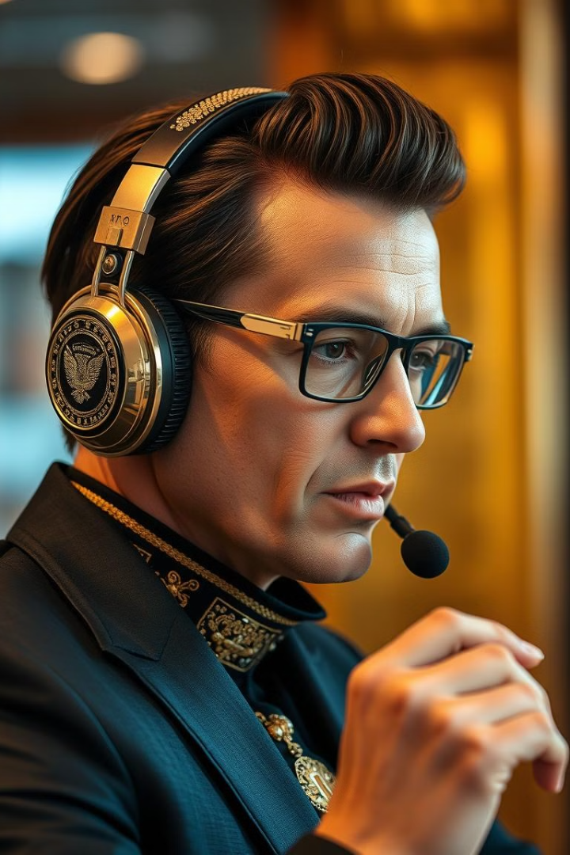
Beyond QWERTY Form Filling:
This presentation explores a project I undertook during my AI internship at Infosys Springboard, where I implemented speech-to-text for form filling and expanded on the project with my own speech synthesis implementation. This project aims to create a more user-friendly and accessible form-filling experience, ultimately enhancing the interaction between users and online forms.
by :-
Seenu Ananth K,
AI Intern,
Infosys SpringBoard.

Slide 2
Introduction
Project Overview
Speech-to-Text
Text-to-Speech
This project involved creating a form-filling system using speech-to-text technology.
Converts spoken words into text, enabling users to fill forms with their voice.
Provides auditory prompts and confirms inputs, making the process more intuitive and error-free.

Slide 3


Objectives
Company Objective
1
Implement speech-to-text for form filling.
My Personal Contribution
2
Implement speech synthesis to provide voice prompts and confirmation, enhancing user interaction.

Slide 4
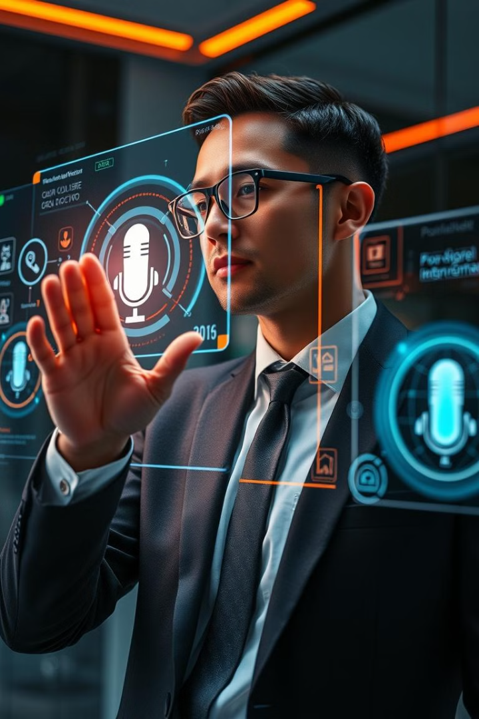
Problem Statement
1
Traditional QWERTY-based form filling is often tedious and time-consuming, especially for lengthy forms.
2
Speech recognition alone is incomplete without validation and confirmation. Users receive no confirmation of their inputs, leading to potential errors.
My Solution : Voice-Enabled Forms
Speech-to-Text
Text-to-Speech
Converts spoken words into text, allowing users to fill forms with their voice.
The system guides users with voice instructions like "Please say your name."
The system reads back user inputs, ensuring accuracy and reducing errors.

Slide 5

Implementation
Voice Prompt
Confirmation
When the form loads, speech synthesis provides initial instructions, such as "Say your name," to guide the user.
Speech synthesis reads back the entered data for verification, allowing users to identify and correct any mistakes in real time.
1
2
3
Speech-to-Text Conversion
The Web Speech API captures the user's voice, converts it into text, and populates the appropriate form fields.

Slide 6
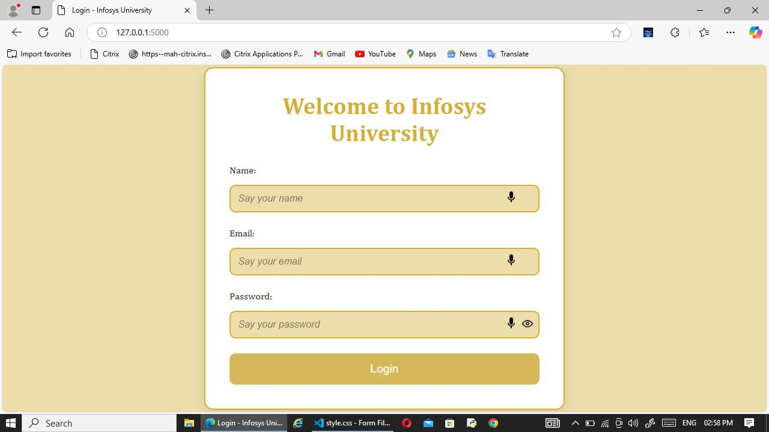
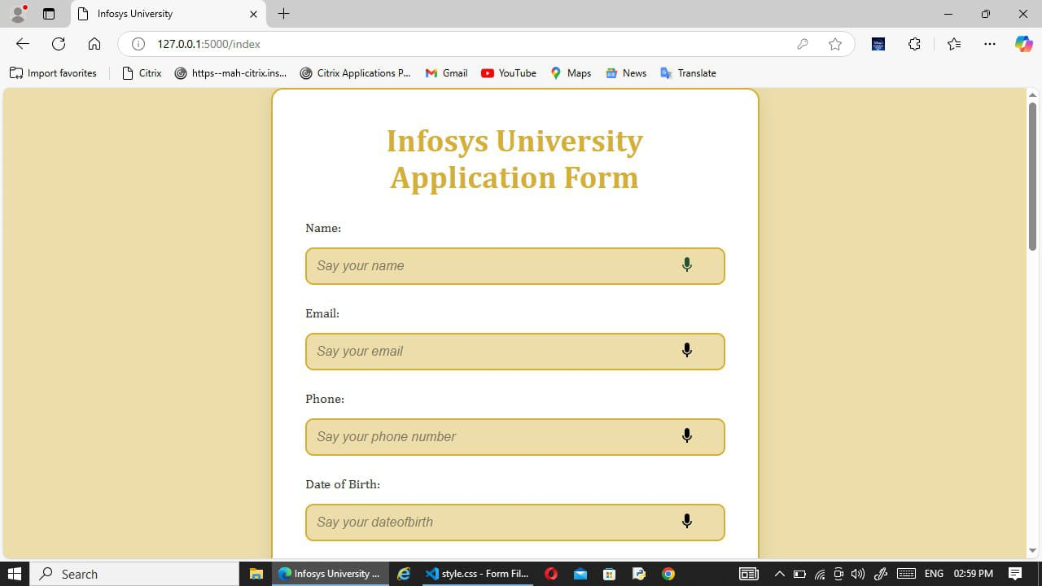
( Source Code )
Output ScreenShots

Slide 7
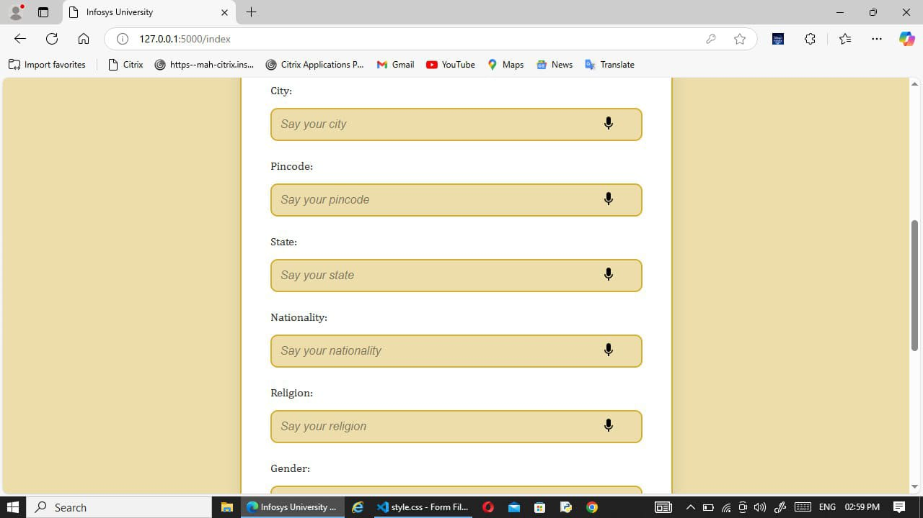
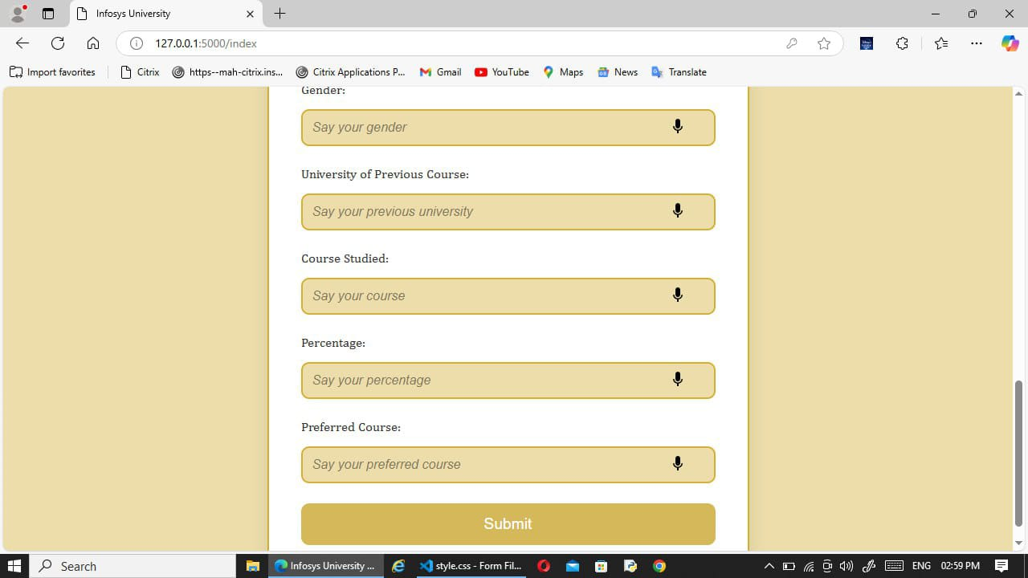

Slide 8
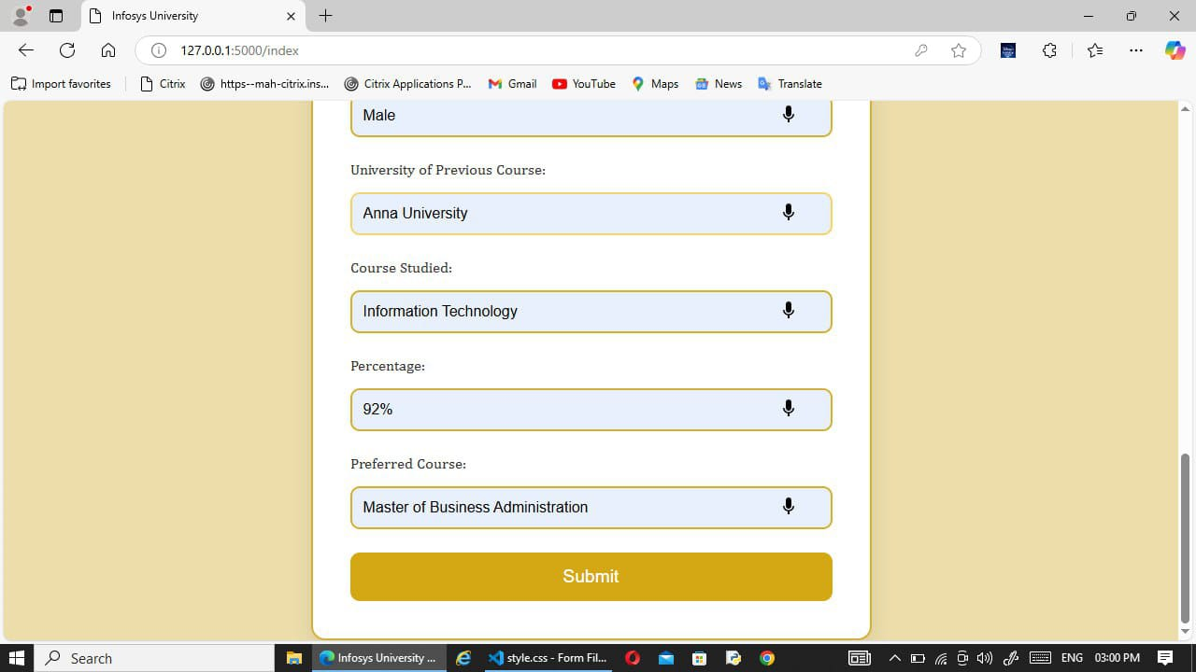
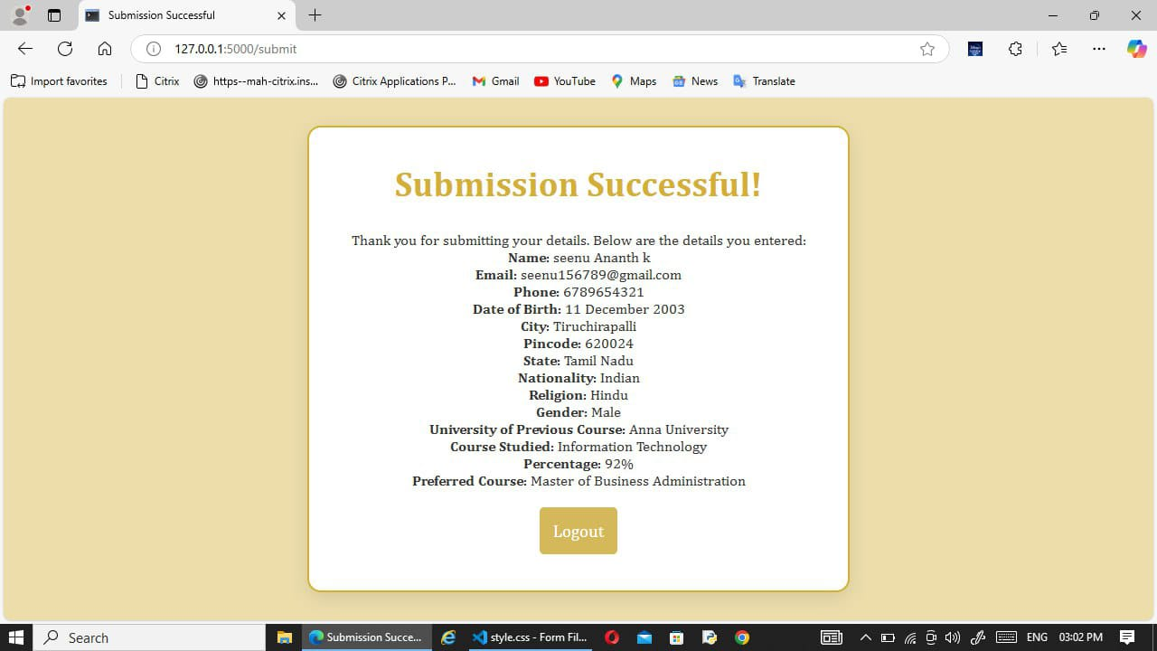

Slide 9
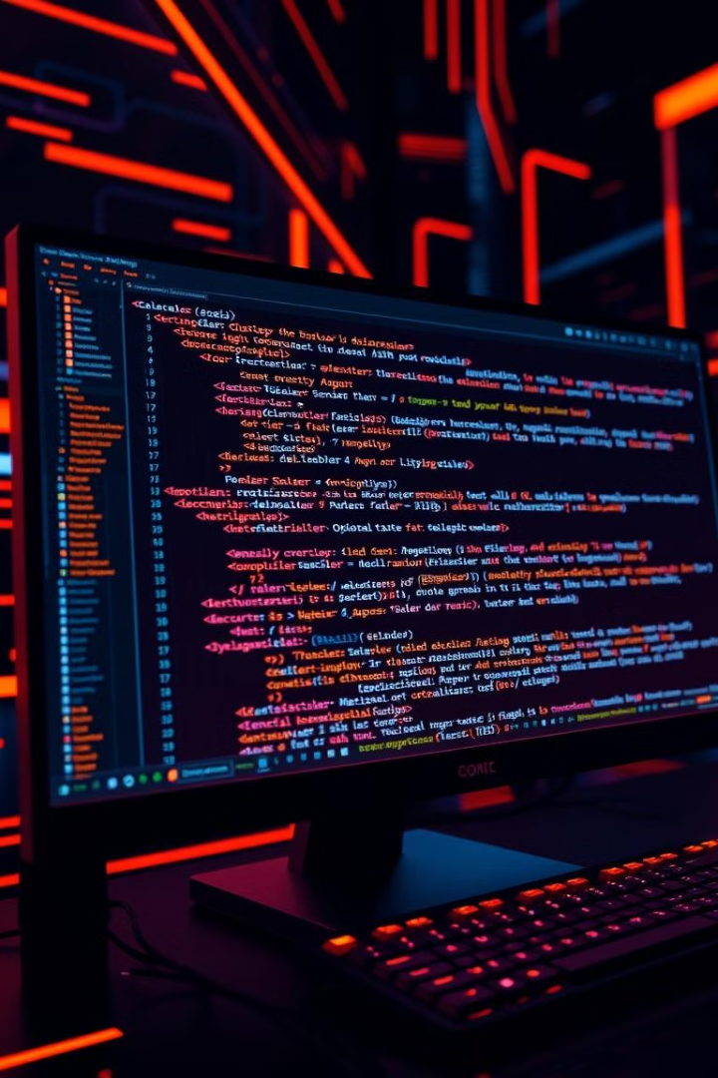



Technology Stack
Front-End
Back-End
HTML, CSS, and JavaScript for building the user interface.
Flask for handling server-side logic and API integration.
APIs
Web Speech API for speech-to-text and speech synthesis.

Slide 10




Benefits of Speech Recognition
Hands-Free Interaction
Simplifies data entry through voice commands.
Faster Input
Reduces the time required for manual typing.
Enhanced Accessibility
Enables users with physical disabilities to fill forms effortlessly.

Slide 11
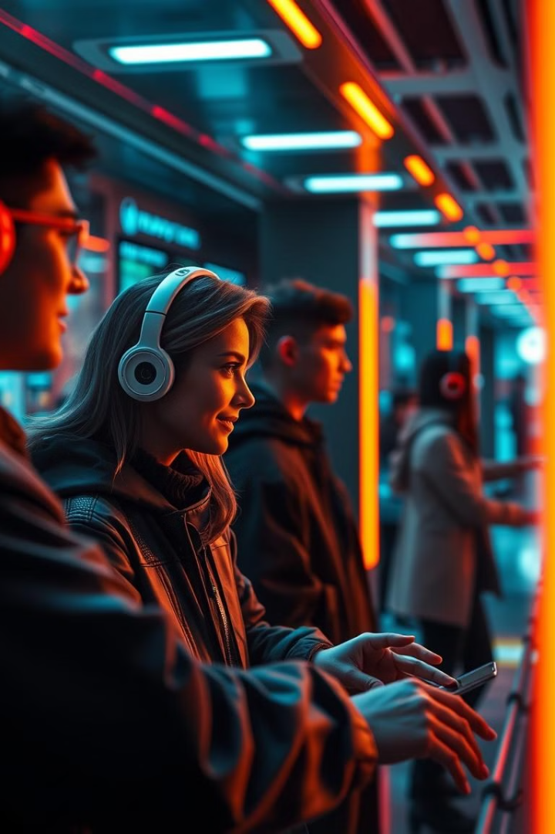
Benefits of Speech Synthesis
( My Personal Contribution )
Real-Time Feedback
Confirms user inputs by reading them aloud, ensuring accuracy.
User Guidance
Provides voice prompts to guide users through the form-filling process.
Error Notification
Alerts users about incorrect inputs, improving interaction quality.

Slide 12

Challenges
Getting the best accuracy in speech recognition was a major challenge. After experimenting with multiple APIs, I selected the Web Speech API for its balance of accuracy and simplicity.
1
2
Words like “Male” being interpreted as “Mail” , resolved by normalizing inputs.
3
Prevented Speech Synthesis from overlapping with recognition.
Learnings
1
Enhanced API integration and debugging skills.
2
Improved input normalization and error handling

Slide 13





Future Scope
1
Multi-language Support
2
Enhanced Accuracy
3
Personalized Voice Synthesis
4
Integration with Other Apps
5
Offline Functionality

Slide 14

Conclusion
This project began with a focus on speech recognition. By integrating speech synthesis, I transformed it into an interactive, user-friendly

